Slide 1

Sender
Hackathon Project

Slide 2

Purpose of our project is to simplify crypto exchange

Slide 3
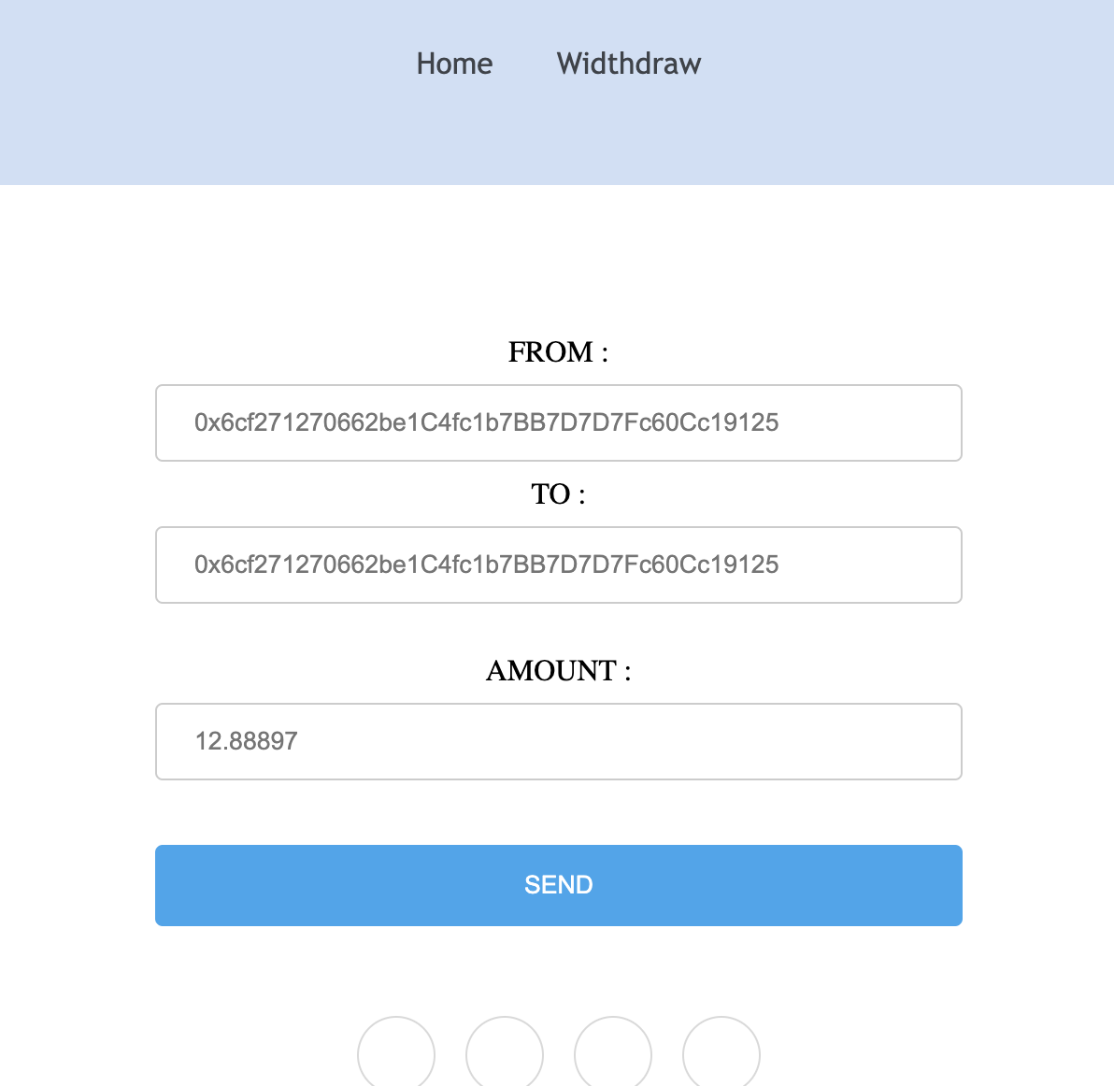
Home page

Slide 4
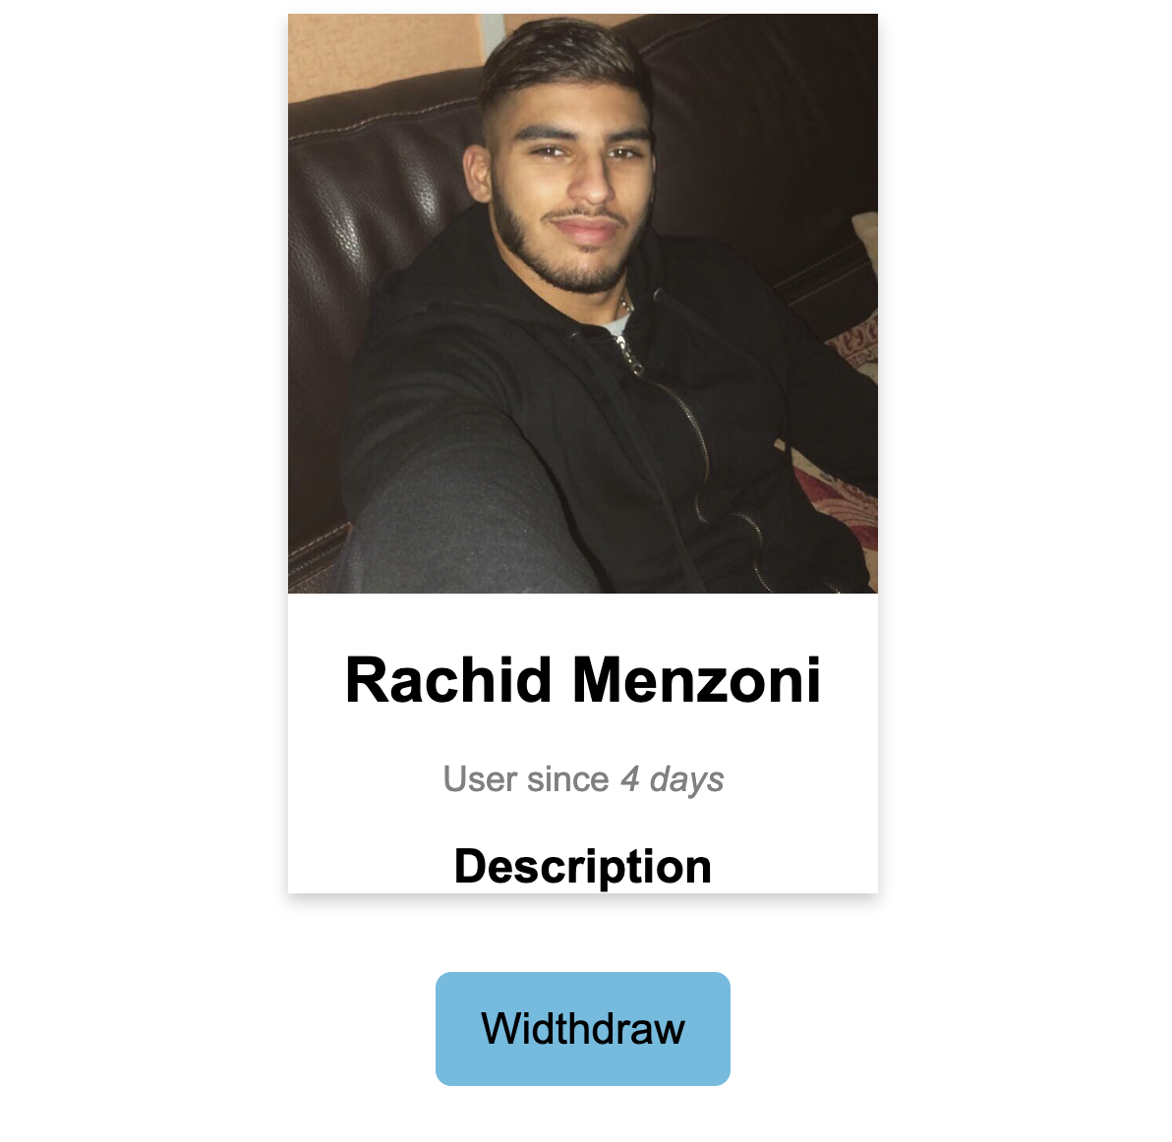
User profile

Slide 5

Sender is a Web3 project with a lot of innovation

